Slide 1

An Overview of .NET
Gavin King
.NET Developer Group
Microsoft Ltd
gking@microsoft.com

Slide 2
Topics
What is .NET?
Introduction to concepts
Tour and demo of the Framework
XML Web services and Industry standards
Free stuff – so pay attention!

Slide 3
So what really is .NET?
Software for connecting people, information, systems and devices?
  Runtime for executing code
  Tools to help develop applications
  Server products to manage applications
  Value-added services
Managed environment for developing and executing components

Slide 4
.NET Framework design goals
Incorporate Web standards and best practices
  Designed with security in mind
Unified programming models
Simplified development
Simple to deploy, run, & maintain

Slide 5


A problem of communication
Application
Code and data structures
Before RPC-style models, applications were completely separate entities with little or no integration…

Slide 6

A problem of communication
…but with RPC or COM, you still have to write ‘plumbing’ code and can’t directly interact…

Slide 7
A problem of communication
… a common language runtime provides components a common substrate. No “plumbing” is needed and objects can directly interact.

Slide 8

Language Interop in the CLR

Slide 9
Framework, languages and tools
VB
C++
C#
JScript
…
Visual Studio.NET
Common Language Specification
ASP.NET
Windows Forms
Data and XML
Base Class Library
Web Matrix
Common Language Runtime
Windows
COM+ Services
Notes:
Lets dive in and have a look at the architecture stack of the .NET platform.

Slide 10
Framework, languages and tools
VB
C++
C#
JScript
…
Visual Studio.NET
Common Language Specification
ASP.NET
Windows Forms
Data and XML
Base Class Library
Web Matrix
Common Language Runtime
Windows
COM+ Services
Notes:
Now on top of the windows platform sits the common language runtime. The CLR has an aboslutely critical role to play.
It is responsible for core services like
Memory allocation and GC
Starting and killing threads and processes
Enforcing security
And managing dependencies with other components.
This in itself isn’t new, but what is different is that it provides a unified environment across all programming languages

Slide 11
Common Language Runtime (CLR)
Base Class Library Support
Thread Support
COM Marshaler
Type Checker
Exception Manager
Security Engine
Debug Engine
IL to Native
Compilers
Code
Manager
Garbage
Collector
Class Loader

Slide 12
Framework, languages and tools
VB
C++
C#
JScript
…
Visual Studio.NET
Common Language Specification
ASP.NET
Windows Forms
Data and XML
Base Class Library
Web Matrix
Common Language Runtime
Windows
COM+ Services
Notes:
Next we provide a framework of simple and extensible class libraries that give developers one single, yet powerful framework to learn.
So if you are a windows developer, you don’t have to learn MFC, VB APIs, and the microsoft foundation classes for Java.
On top of that we provide data access mechanisms and the ability to handle XML.
On top of that we provide ASP .NET – a web model for building powerful web pages and infrastructure. And windows forms, for quickly building powerful graphical applications.

Slide 13
Framework, languages and tools
VB
C++
C#
JScript
…
Visual Studio.NET
Common Language Specification
ASP.NET
Windows Forms
Data and XML
Base Class Library
Web Matrix
Common Language Runtime
Windows
COM+ Services
Notes:
What really sets the .NET framework apart is its ability to support many programming languages – allowing developers to code with:
Whatever language they know
What is best for the job
This is made possible by a common language spec which dictates that each language can access the same class libraries and has generates intermediate language

Slide 14

Multilingual Development
Fortran
Perl
Scheme
Smalltalk
Python
Ada
Component Pascal
Oberon
Mercury
Visual Basic
Delphi
C#
Oz
C++
Mondrian
J#
C
Pascal
JScript
APL
Java
Haskell
Eiffel
Cobol
RPG
Objective Caml
ML
Notes:
In addition to the key MS languages, we have support for well over 20 others from third party vendors…
…from the Antique (Cobol) to the rigorous (like Eiffel)
This approach means it is even possible to mix and match within one project – even debugging amongst languages.

Slide 15
Framework, languages and tools
VB
C++
C#
JScript
…
Visual Studio.NET
Common Language Specification
ASP.NET
Windows Forms
Data and XML
Base Class Library
Web Matrix
Common Language Runtime
Windows
COM+ Services
Notes:
The last piece of this architecture is of course the tools and facilities to make coding as easy as possible.
Visual Studio .NET is one of the most productive development tools available today – providing not only features for developers to rapidly create reliable, scalable and secure code, collaborate in project teams. But also enabling architects to rigourously define the software blueprint of any large-scale architecture.

Slide 16

What Is A Web Service?
Web Service
Open
Internet
Protocols
A programmable application component accessible via standard Web protocols
Provide a Directory of Services on the Internet
UDDI
Universal Description,
Design, and Integration
Web Services are defined in terms of the formats and ordering of messages
WSDL
Web Services
Description Language
Web Services consumers can send and receive messages using XML
SOAP
XML & HTTP
Built using open Internet protocols

Slide 17
Creating and consuming XML Web services

Slide 18
ASP .NET Web Matrix Project
Lightweight, simple, community-oriented tool for building ASP.NET apps
Full WYSIWYG support
Small (~ 1.4 Mb)
Community features
  IM integration, code sharing, chat features
Available free-of-charge at www.asp.net

Slide 19
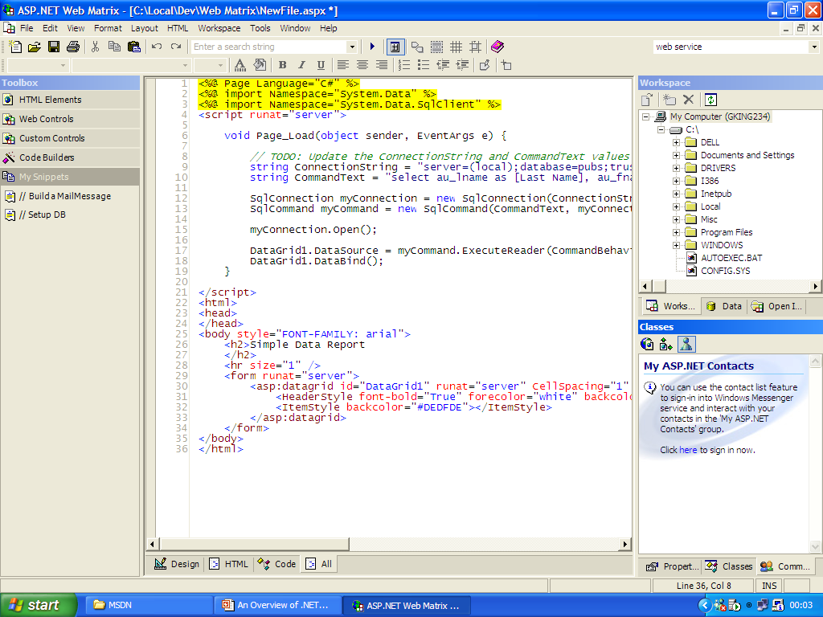
WYSIWYG Controls
Snippets and code sharing
Community
Support
Notes:
Here’s a quick screenshot of web matrix in action
I could tell you about this, that or the other but the bottom line is that there is so much good stuff in here. And it is completely free!!!

Slide 20
The role of open standards
.NET has been ratified through ECMA standards
  ECMA-335 Common Language Infrastructure (CLI)
  ECMA-334 C# Language
  Participants include Intel, HP, IBM, Netscape
.NET is Microsoft’s commercial implementation of these standards
Some platform specifics have not been included
  Windows Forms
  ADO.NET
Notes:
So that was a very quick overview of the .NET Fx stack from top to bottom
You’ll find that at the heart of the framework lies many open standards. In fact MS joined forces with other industry vendors to make .NET itself a standard.
So one way of looking at the .NET framework is as a commercial imp of these.

Slide 21
An open framework
VB
C++
C#
JScript
C#
JScript
…
Visual Studio.NET
Common Language Specification
Common Language Specification
ASP.NET
Windows Forms
Data and XML
Base Class Library
Base Class Library
Web Matrix
Common Language Runtime
Common Language Runtime
Windows
COM+ Services
Windows
FreeBSD
…
Notes:
Lets revisit the framework again and see what it is we have – leaving out only the platform specifics stuff like win forms.
The reality therefore is that instead of .NET running on Windows, it could potentially run on any platform – leaving the door open for other vendors or third-parties.

Slide 22
Shared Source CLI (Rotor)
Non-commercial implementation
Available for research, academic and other non-profit use
  Standards are available to everyone for profitable use too, of course
Written entirely in C#
Available for FreeBSD and WinXP
  Ximian and Intel are developing Linux implementations at the moment
Implemented for teaching, learning and research
Notes:
We have also taken this standard process one step further.
By providing an example implementation of the ECMA standards, formally known as codename Rotor.
The shared source CLI provides an excellent base for anyone interested in compiler technology or someone just seeking a deeper understanding of the .NET Fx.
At the moment we have released for FreeBSD, but Ximian and intel are currently developing Linux versions. So watch this space!

Slide 23
MSDN Academic Alliance
Provides access to Microsoft software for research and education purposes
Licensed to CS departments for student loans
Includes:
Operating Systems, SDKs, DDKs
Visual Studio .NET AE
Server Platforms
  Windows, SQL Server, Exchange Server, Commerce Server, BizTalk Server, Host Integration Server, Application Center. . .
Latest updates and Betas
MSDN Library
Dev tools for WindowsCE/PocketPC 2002
4 Technical Support incidents
Visio
Regular Updates

Slide 24
Summary
.NET is a platform that solves many computing problems
Be sure to get access to free Microsoft software
  MSDN AA & Web Matrix
Check out the Technically Ahead tour bus on campus today

Slide 25
Pop Quiz
What is .NET?
What is the name of the free web development tool?
What standardisation body is Rotor submitted to?

Slide 26
Resources
http://www.asp.net
http://www.gotdotnet.com
http://msdn.microsoft.com
http://www.microsoft.com/uk/education/techtour/

Slide 27


